Slide 1


Amharic Morphological Segmentation using bidirectional LSTM neural network and rule-based segmentation

Slide 2
Outline
1
Introduction
5
Result and Discussion
2
Challenges
6
Conclusion
3
Objective
4
Methodology

Slide 3

The process of breaking down words into their component morphemes, which are the smallest units of meaning.
Morphological segmentation is especially important for languages with complex morphology, such as Amharic, Tigregna and Afan Oromo.
Morphology?
Machine translation
Information retrieval
Speech recognition and others
Can be particularly used in applications
Source: Gartner

Slide 4
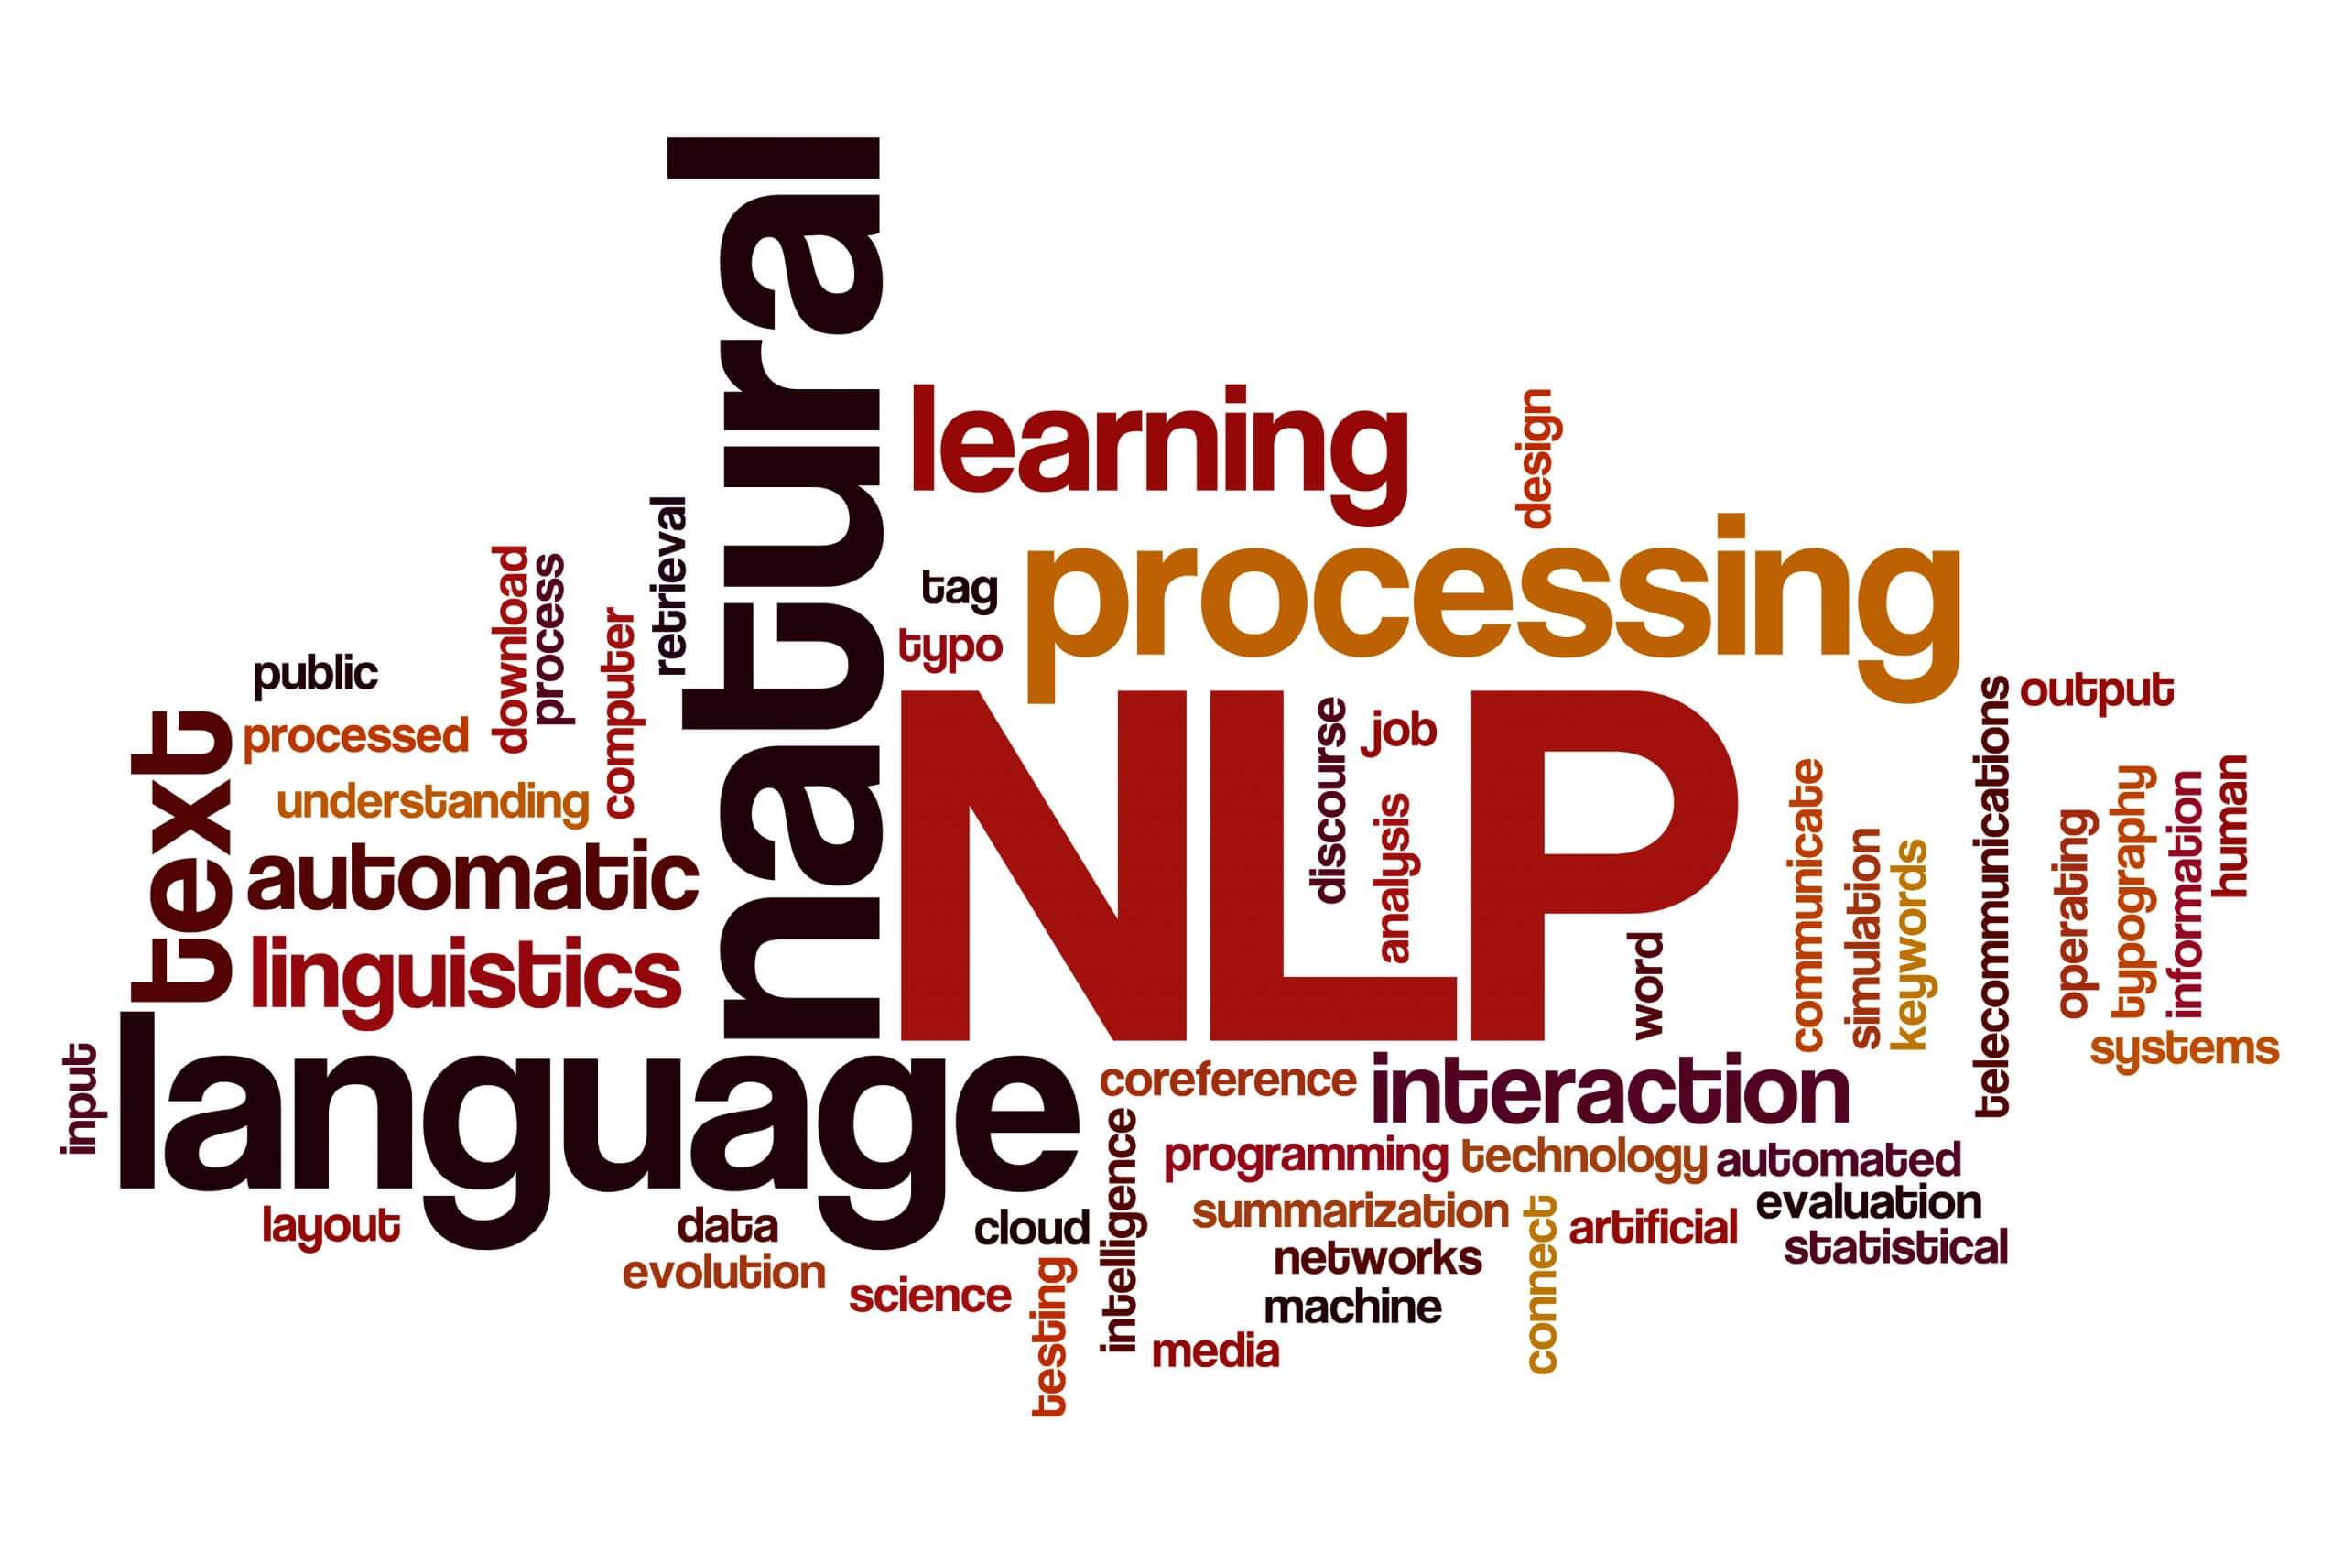
Challenges
Highly inflectional nature
Agglutinative nature
Lack of standardization
Lack of resources

Slide 5
The primary goal of this project is to achieve Amharic morphological segmentation through the integration of deep learning and rule-based segmentation techniques. The purpose is to break down words into their constituent morphemes, which will facilitate more precise natural language processing.
Objective
Preprocessing and feature extraction
Data Collections
Model development
Specific objective
Source: Gartner

Slide 6
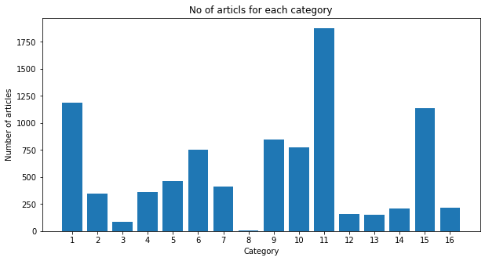
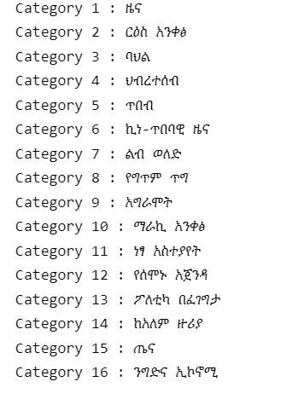
Methodology
Data Collection
Web Scrapped from www.fanabc.com
Fig 1. 1:ህብረተሰብ , 2:ልብ ወለድ , 3:ማራኪ አንቀፅ , 4:ርዕስ አንቀፅ , 5:ባህል , 6:ነፃ አስተያየት , 7:ንግድና ኢኮኖሚ , 8:አግራሞት , 9:ከአለም ዙሪያ , 10:ኪነ-ጥበባዊ ዜና , 11:ዜና , 12:የሰሞኑ አጀንዳ , 13:የግጥም ጥግ , 14:ጤና , 15:ጥበብ , እና 16:ፖለቲካ በፈገግታ ,

Slide 7
Methodology
Data Preprocessing
Removed punctuation and special chars
Removed non Amharic ascii and numbers
Normalized char level replacement
Tokenize word form sentence
Remove duplicate word from tokenized_word_list
Before removed duplicated word: 5802093
After removed duplicated word: 447137

Slide 8
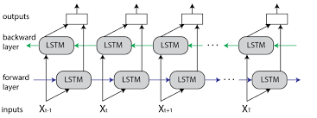
Methodology
Model development
Leveraging unsupervised deep learning and rule-based segmentation techniques to create a robust and accurate system for segmenting words into their constituent morphemes.
Bidirectional LSTM neural network
Rule-based segmentation algorithm

Slide 9
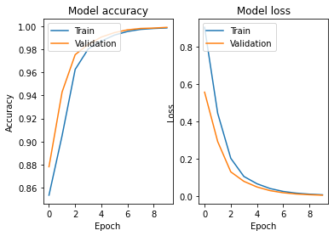



Result and Discussion
Bidirectional LSTM neural network model result
Test loss: 0.0056,
Test accuracy: 0.999
Training accuracy: 0.9985
Rule-based segmentation algorithm

Slide 10
Conclusion
The model achieved an accuracy of 99.85% using unsupervised deep learning techniques, and this was combined with rule-based segmentation to predict the segmentation of Amharic words.

Slide 11
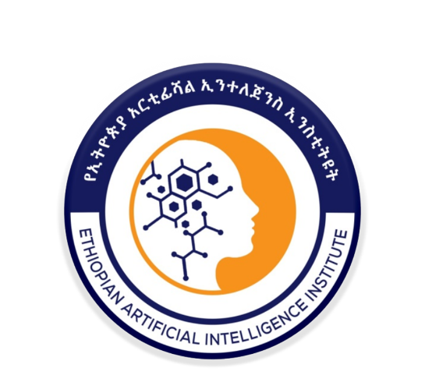
THANK YOU!
Q & A

